Slide 1
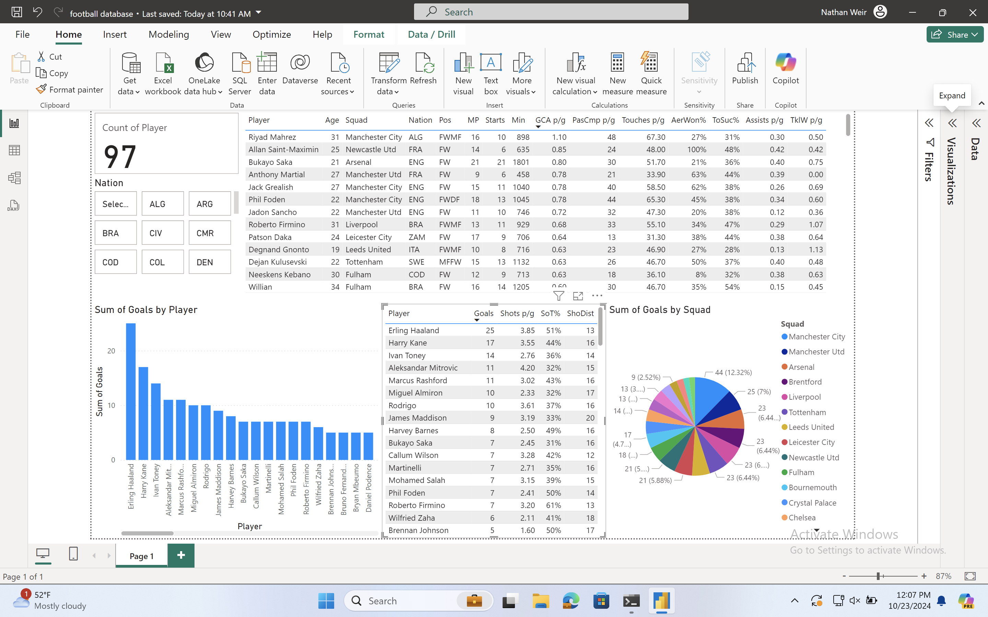
2022/23 Premier League forward player statistics (First 23 games)
Nathan Weir

Slide 2
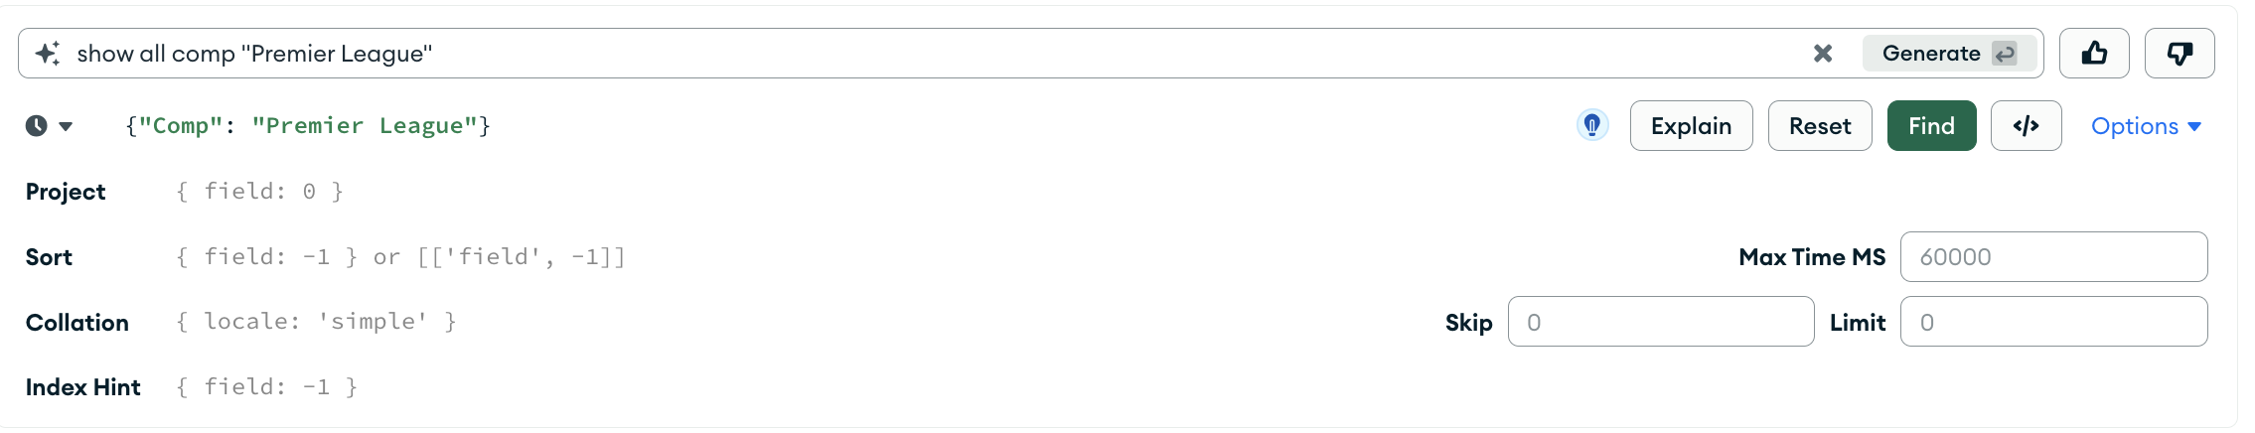
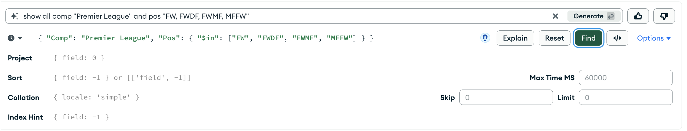
The Dataset and MongoDB Queries
I selected a large dataset that gives in-depth in-game statistics from football’s top 5 European leagues for the first 23 league games of the 2022/23 season.
Next, I downloaded this dataset from Kaggle.
I then converted it from a CSV to a JSON file.
Finally, I loaded my dataset into MongoDB. As this was a very comprehensive dataset with over 100 columns and 1000 rows, there was lots of data to remove.
Using Mongo DB’s generative query, I was able to run multiple queries on my dataset to filter the dataset to only show forward players from the premier league (including attacking midfielders).

Slide 3
PowerBI analysis - ETL process
I first transformed my data from PowerBI into Power Query to clean the dataset.
Using Power Query I:
Removed irrelevant columns, e.g. metrics such as interceptions, progressive carries, long-distance passes ect.
Changed unreadable characters in player names such as letters with an accent in them to an English version without an accent. I did this by using the text filter and replace values function for the player names column and changing each name so that all the characters were displayed correctly. I then cleared the filter so that all the players names were displayed again along with the edited ones.
Corrected data types and formatting for each column to allow for comparison and analysis.
Finally I loaded my data back into PowerBI and finally adjusted the numerical data to 2 decimal places.
Notes:
Removed irrelevant columns, e.g. metrics such as interceptions, progressive carries, long-distance passes ect. as these are not typically useful for evaluating forward players, as these actions are not part of their role in a team and so these actions are rarely carried out by forward players. Consequently, these statistics do not provide meaningful indicators of forward performance or a reliable bases for player comparisons.

Slide 4
Currently, the visuals display the data for all 97 players included in the analysis.
The larger table orders players by the highest to lowest GCA p/g, as seen Riyad Mahrez has the highest GCA p/g with 1.10.
The smaller table orders players by highest to lowest goals scored, with Erling Haaland on top with 25 goals.
The pie chart shows that Manchester City scored the most goals during the season with 44, 12.3% of the league's total.

Slide 5
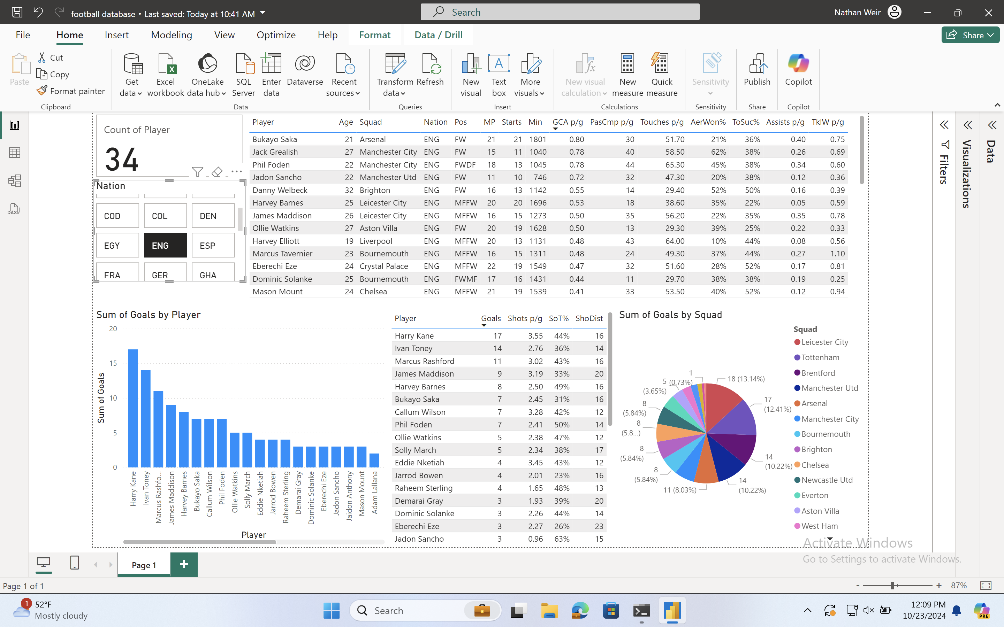
I have now used the slicer to show data for only the English players (34) in the league.
As we can see Harry Kane is the top-scoring English player in the premier league during this season. With Bukayo Saka topping the chart in GCA per game.
Leicester City have the highest number of goals scored by English players during the season with 18 goals.

Slide 6
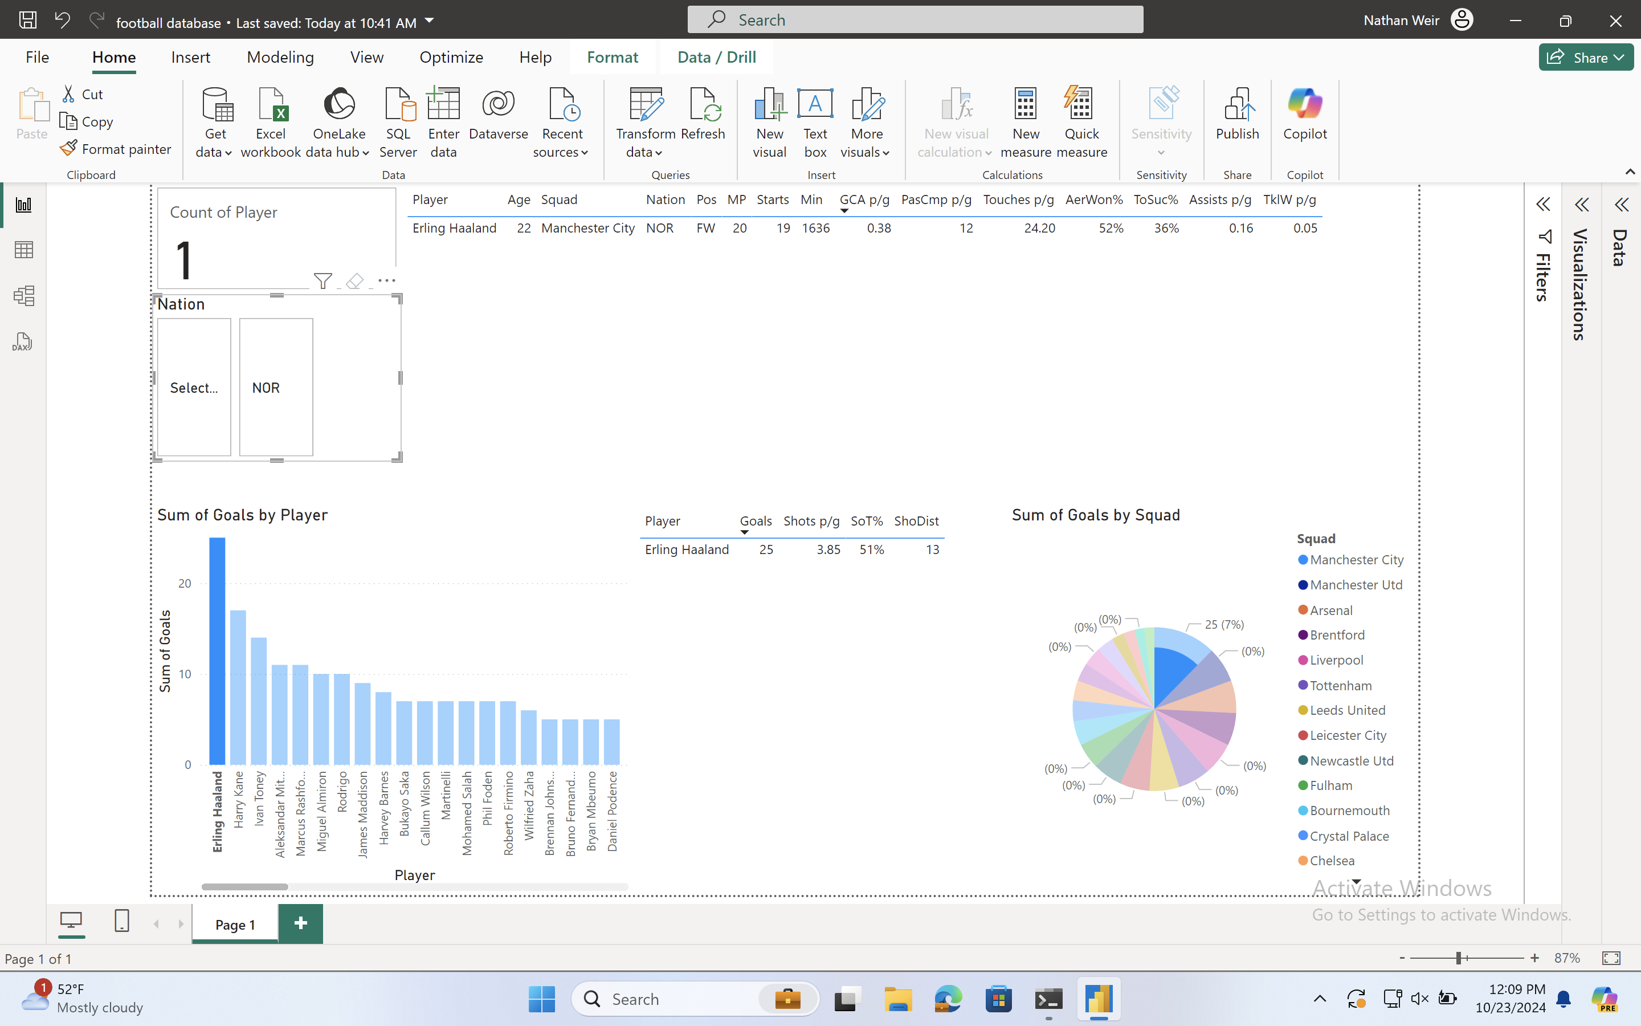
I have now selected only one player (Erling Haaland) to analyse.
We can see he has 25 goals this season from 20 matches or 1636 minutes of football!
On average per game, he completes 12 passes, has 24 touches and 3.85 shots. 51% of his shots are on target and his average shooting distance is 13 yards from goal.
Additionally, he has a take-on success rate of 36% and an aerial duel win rate of 52%.

Slide 7
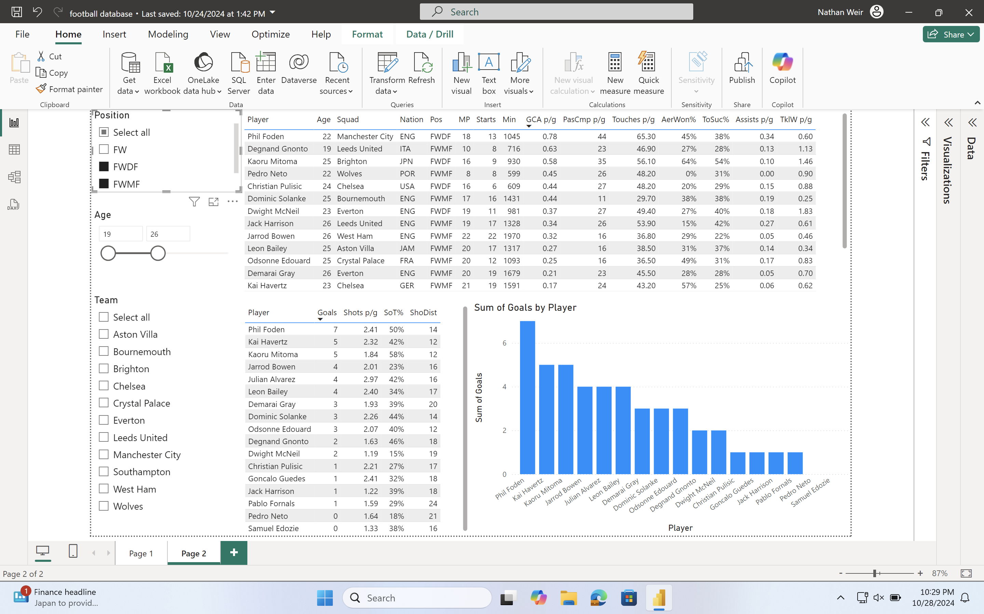
This page shows three of the four visuals from the page 1 but with different slicers.
Using a slicer I have filtered the dashboard to only show wingers and attacking midfield players (FWMF and FWDF). Furthermore, I have used a slicer for age to show players aged between 19 and 26.
By filtering the data this way, we can see that Phil Foden has scored the most goals and has the highest GCA p/g. Therefore, he is the most effective player in this category within this bracket of players.

Slide 8

Conclusions
Key findings:
Manchester City were the best attacking team of the 2022/23 season. This is largely due to Erling Haaland leading the league in goals and Manchester City having 3 players in the top 6 for goal-creating actions per game.
8 of the top 14 goal scorers in the league are English, the most prolific being Harry Kane.
Practical Application:
Football clubs may use this analysis to identify forward players to target in the transfer window based on specific characteristics. For example, a team that plays lots of direct long passes would filter this data to identify players with the highest aerial duel win percentage and look to recruit them as these players would excel in this team's style of play.

